Slide 1

Lending Club Case Study
By Ravi Theja and Bhushan Pande

Slide 2

Problem Statement
To identify patterns from data provided which indicate if a person who applied for loan is likely to default. Based on the patterns company can take decisions such as denying the loan, reducing the amount of loan, lending (to risky applicants) at a higher interest rate, etc.
In other words, the company wants to understand the driving factors (or driver variables) behind loan default, i.e. the variables which are strong indicators of default. The company can utilize this knowledge for its portfolio and risk assessment.

Slide 3
Steps for EDA
Data Cleaning
Deleting columns which are not required for analysis.
Deleting columns which have single value or constant value for all rows.
Dropping rows which have null values
Data Conversion – Converting column values to appropriate datatypes which can be used for analysis.
Derived columns - Create new columns to get additional insights
Univariate and Bivariate analysis
Correlation Analysis
Observations and Conclusion

Slide 4
Driver variables for loan default
Interest Rate.
Annual Income.
Loan Amount.
Grade of the Loan.
Purpose of the Loan.
Public record for bankruptcies.
Employment Length.

Slide 5
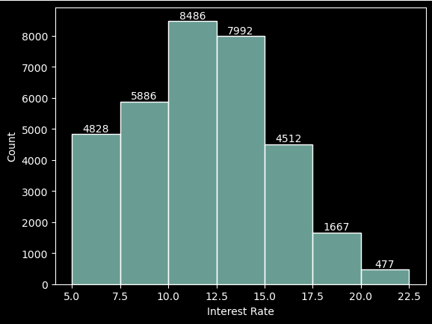
Interest Rate
Observations:
Average loan interest rate is 11.82%.
Most approved loans have an interest rate between 10-12.5%.
Interest rate less than 9% has very less chances of default. Interest rates are starting from minimum 5 %.
Most applicants have defaulted on loans where the interest rate was more than 15%.
Loan default proportion increases with higher interest rates.

Slide 6
Annual Income
Observations:
Interest rate less than 9% has very less chances of default. Interest rates are starting from minimum 5 %.
Most applicants have defaulted on loans where the interest rate was more than 15%.
Loan default proportion increases with higher interest rates.

Slide 7
Loan Amount
Observations:
Interest rate less than 9% has very less chances of default. Interest rates are starting from minimum 5 %.
Most applicants have defaulted on loans where the interest rate was more than 15%.
Loan default proportion increases with higher interest rates.

Slide 8
Grade
Observations:
Interest rate less than 9% has very less chances of default. Interest rates are starting from minimum 5 %.
Most applicants have defaulted on loans where the interest rate was more than 15%.
Loan default proportion increases with higher interest rates.

Slide 9
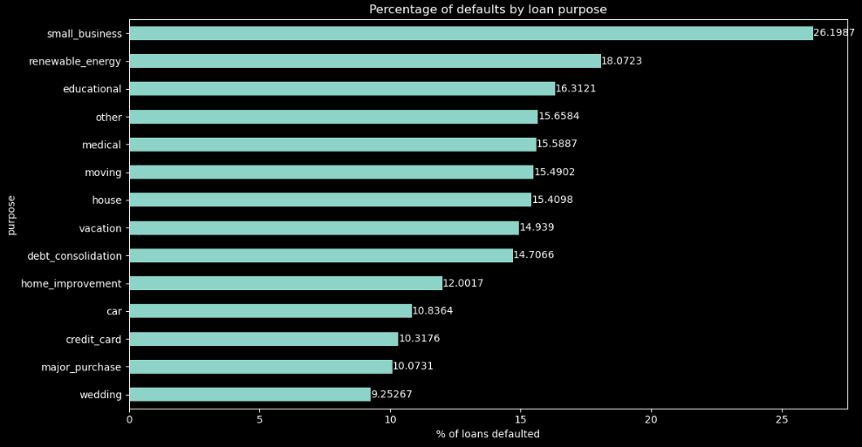
Purpose
Observations:
Interest rate less than 9% has very less chances of default. Interest rates are starting from minimum 5 %.
Most applicants have defaulted on loans where the interest rate was more than 15%.
Loan default proportion increases with higher interest rates.

Slide 10
Public record for bankruptcies.
Observations:
Interest rate less than 9% has very less chances of default. Interest rates are starting from minimum 5 %.
Most applicants have defaulted on loans where the interest rate was more than 15%.
Loan default proportion increases with higher interest rates.

Slide 11
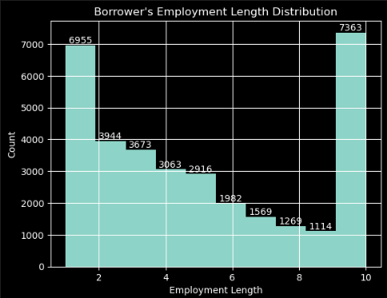
Employment Length.
Observations:
Interest rate less than 9% has very less chances of default. Interest rates are starting from minimum 5 %.
Most applicants have defaulted on loans where the interest rate was more than 15%.
Loan default proportion increases with higher interest rates.

Slide 12

Patterns resulting in loan defaults.
Observations:
* Interest rate less than 9% has very less chances of charged off. Interest rates are starting from minimun 5 %.
* Interest rate more than 16% has good chance of charged off as compared to other category interest rates.
* Charged off proportion is increasing with higher interest rates.

Slide 13
Thank you

